Slide 1

Handwriting Sentiment Classifier
Ernawaty, Xiao Yao, Rachel Chuang

Slide 2

Business View
OBJECTIVE:
Develop a tool that can help professionals, such as psychologists and graphologists, analyze emotions based on handwriting patterns.
Automate emotional analysis to improve efficiency in detecting stress or mental health states based on handwriting.

Slide 3
Business View
MARKET DEMAND:
Field of emotion detection is estimated to reach global market of several billion dollars by 2025 due to adoption of AI
Growing interest in non-invasive mental health assessment tools.
Could be used in various sectors: education, healthcare, and even HR for mental well-being assessments.

Slide 4
Business View
GOAL:
To create practical machine learning model
Helps to classify emotions, assisting professionals in understanding emotional states through handwriting.

Slide 5
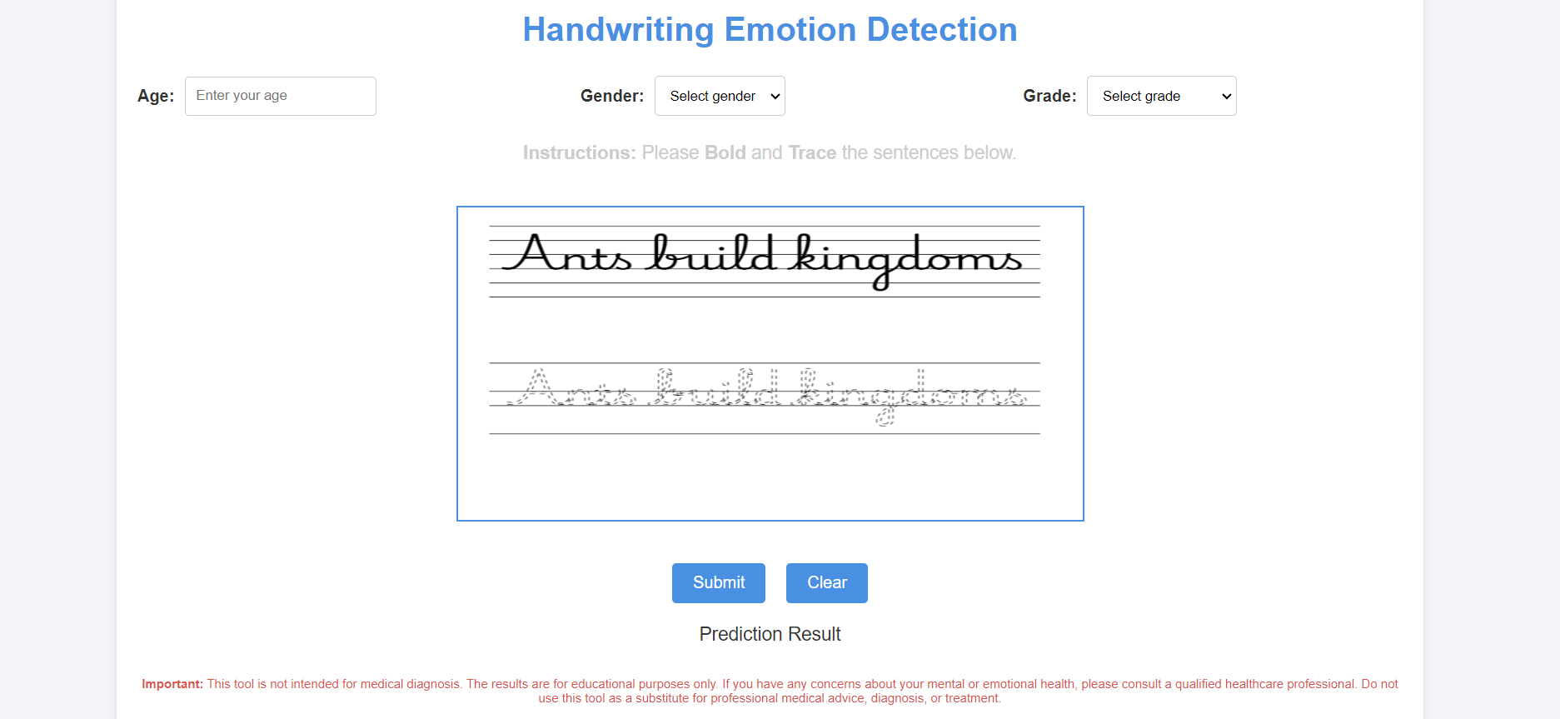

Slide 6
Data Collection Process
Handwriting Data Collection:
Data was collected using handwriting samples from 100 students.
Handwriting was analyzed using digital means to extract features such as speed, pressure, azimuth, and tilt (for altitude).

Slide 7
Data Collection Process
Demographics:
Information about the age, gender, and grade level (education status) of the individual was also collected.
Emotional Labels:
Each handwriting sample was labeled with either a positive or negative emotion, based on psychological assessment.

Slide 8
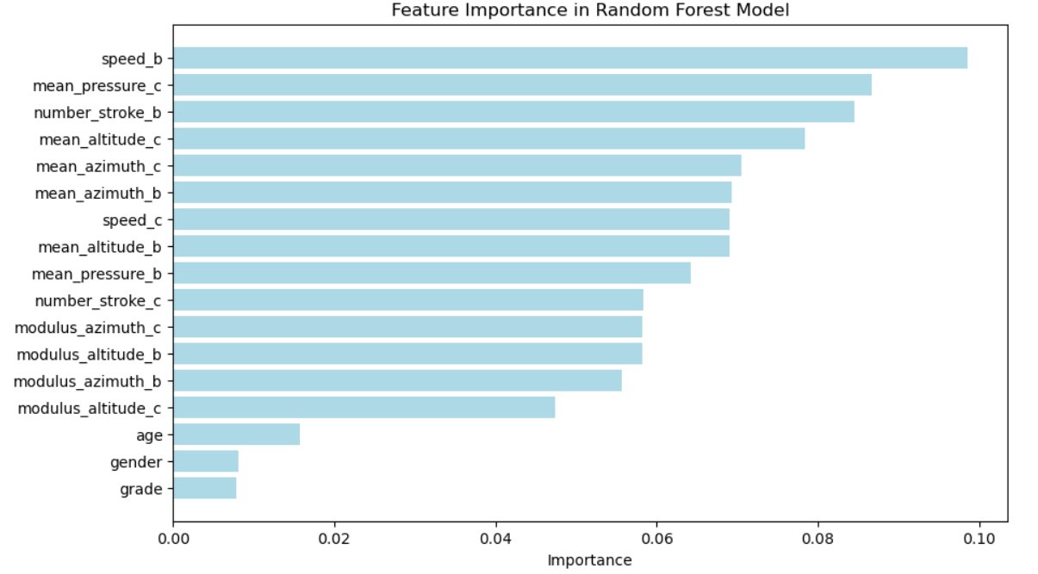
Variables in the Dataset
Variables Excluded:
Age, Gender, and Grade were collected but excluded as they were deemed to introduce noise without adding predictive value.

Slide 9
Variables in the Dataset
Independent (X) Variables Used in the Model
Cursive and Bold related Features:
Speed
Number of strokes
Mean pressure
Mean altitude
Modulus altitude
Mean azimuth
Modulus azimuth

Slide 10
Variables in the Dataset
Dependent (y) Variable (Target –y):
Emotion Label:
Positive (1)
Negative (0)

Slide 11
Model Selection Process
Model Used:
Random Forest Classifier (fine-tuned for better performance).
Steps to Determine the Best Model:
RandomizedSearchCv:
Random search over hyperparameter space to find the best combination of parameters.
Evaluated using 5-fold StratifiedKFold cross-validation
GridSearchCV:
Fine-tuning after identifying optimal parameters from the random search.

Slide 12
Performance and Accuracy Evaluation
Accuracy Results:
Fine-tuned Random Forest Model Accuracy:
Test Accuracy: 1.0
Validation Accuracy : 1.0
Cross-Validation Mean Accuracy: 0.976
This high accuracy across test, validation, and cross-validation indicates that the model is well-optimized.

Slide 13
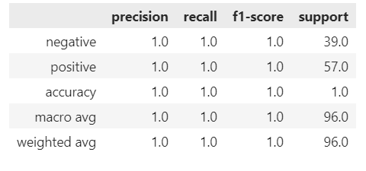
Performance and Accuracy Evaluation
Classification Report:
Precision, Recall, F1-score:
For both “negative” and “positive” labels, precision, recall, and F1-score are 1.0
Precision: 1.0 indicates that all positive predictions are true positives.
Recall: 1.0 indicates that all actual positive instances were correctly identified.
F1-score: 1.0, which is the harmonic mean of precision and recall – showing model has a perfect balance between these two metrics.

Slide 14
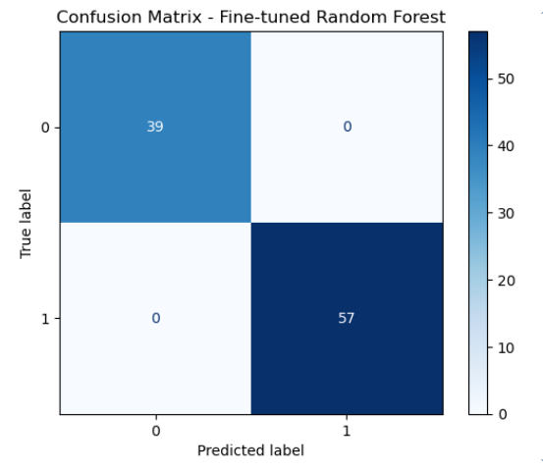
Fine-tuned Random Forest Model
Confusion Matrix:
Shows how well the model predicts positive and negative emotions:
True Positives: Correctly predicted positive emotions.
True Negatives: Correctly predicted negative emotions.
False Positive/Negatives: None, indicating 100% accuracy on the test set.

Slide 15
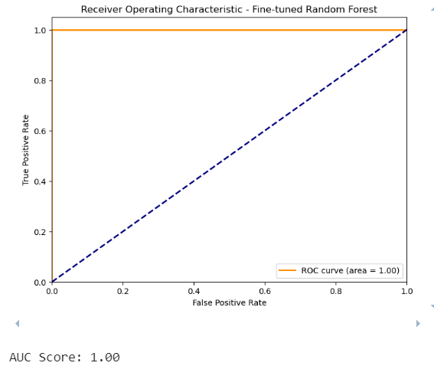
Fine-tuned Random Forest Model
ROC Curve:
Shows the model perfectly distinguishes between positive and negative emotions – Area under the Curve (AUC) score is 1.00

Slide 16
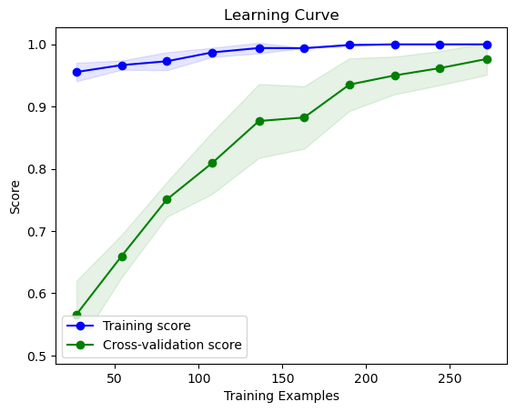
Fine-tuned Random Forest Model
Learning Curve
Indicates a consistent improvement in cross-validation scores as more data is used.
Adding more training data may continue to improve model performance.

Slide 17
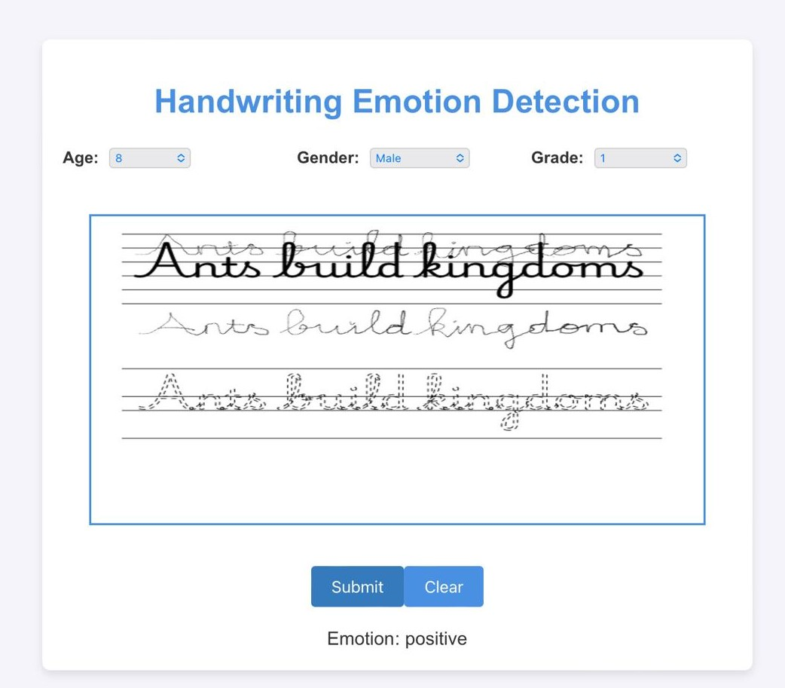
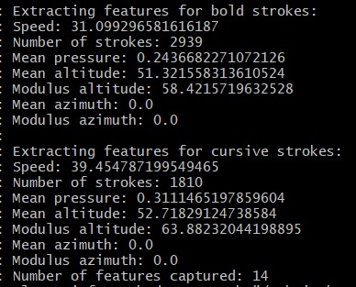
Testing
BACK END
FRONT END

Slide 18
Limitations of the Model
Overfitting:
Shows perfect accuracy on both training and test sets - model may not generalize well to unseen data.
Small Dataset:
Model is trained on a limited dataset – not represent the full variety of handwriting and emotional states.
Specific Device Requirements:
The accurate measurement of pressure, altitude, and azimuth requires the use of specialized devices.

Slide 19
Future Developments
Feature Engineering:
Explore additional features from handwriting, such as signature traits, spacing, and curvature, to improve prediction power.
Real-time Handwriting Analysis:
Develop the model to work in real-time applications, where users can submit handwriting samples via digital devices for instant emotion detection.
Integration with Other Tools:
Integrate the handwriting emotion detection model with other mental health tools for a comprehensive emotional health assessment.

Slide 20
Conclusion
Key Takeaways:
The fine-tuned Random Forest model accurately predicts emotions based on handwriting features, with a 100% accuracy and perfect AUC score on the test data.
Impact:
This tool could serve as an innovative method for assessing emotions, offering potential use cases in education, healthcare, and employee wellness programs.
Next Steps:
Address limitations, expand the dataset, and develop real-world applications to make handwriting emotion detection a viable tool for professionals.

Slide 21
THANK YOU
"The art of writing is the art of discovering what you believe." — Gustave Flaubert

